Slide 1
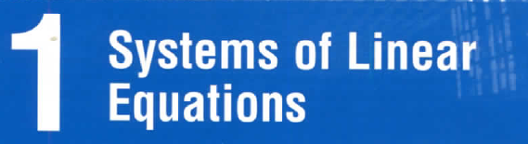
Linear Algebra - Chapter 1

Slide 2
OUR GOAL
Elementary Operations
Gaussian Elimination
Homogeneous Equations

Slide 3
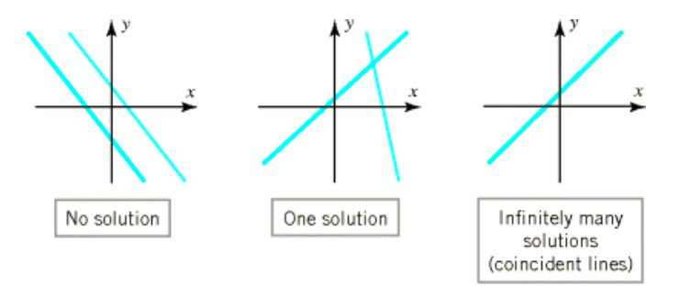
ax + by = c

Slide 4
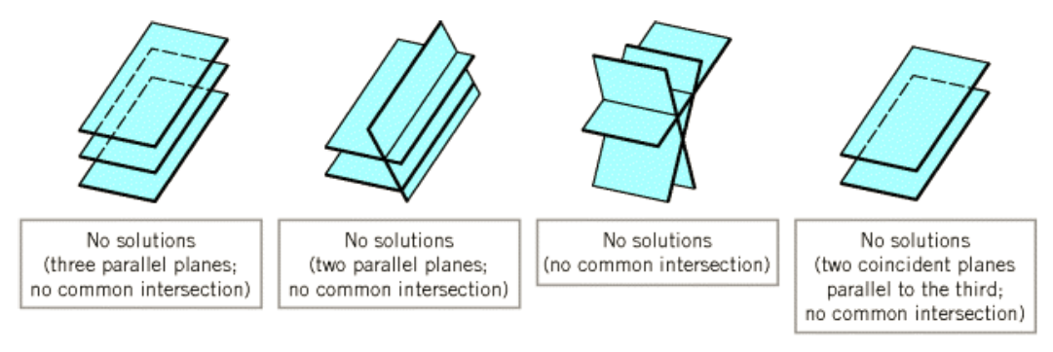
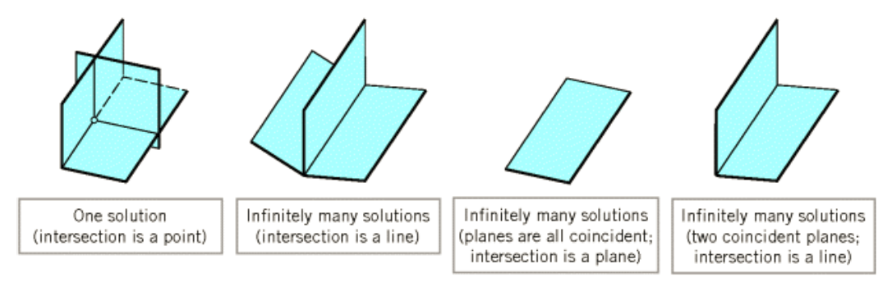
ax + by + cz = d

Slide 5
1.1. Solutions and Elementary Operations
coefficients
variables = unknowns
a₁x₁+ a₂x₂+…+a_{n}x_{n}=b
is called a linear equation (phương trình tuyến tính)
If a₁s₁+a₂s₂+…+a_{n}s_{n}= b
➔ (s₁,s₂,…,s_{n}) is called solution of the equation
A system may have:
no solution
unique solution
an infinite family of solutions
0
1
◎

Slide 6
Inconsistent (không tương thích) | Consistent (tương thích)
No solutions ( vô nghiệm) | Unique solution (nghiệm duy nhất) | Infinitely many solutions (vô số nghiệm)

Slide 7
Example 1
no solution
(0,2,1), (2,0,1)
(t,2-t,1)
Consistent
(infinitely many solutions)
Inconsistent
(t,2-t,1) is called a general solution and
given in parametric form, t is parameter
( t is arbitrary)

Slide 8
Algebraic Method
augmented matrix
coefficient matrix
constant matrix

Slide 9
Example 2
Consider the system
augmented matrix

Slide 10
Example 2
Solution (0,-1)

Slide 11
A row-echelon matrix has 3 properties
All the zero rows are at the bottom
The first nonzero entry from the left in each nonzero row is a 1, called the leading 1 for that row
Each leading 1 is to the right of all leading 1’s in the rows above it

Slide 12
Row-echelon matrix
The row-echelon matrix has the “staircase” form
leading ones
( for any choice in *-position )

Slide 13
Which is a row-echelon matrix?

Slide 14
A reduced row-echelon matrix (ma trận bậc thang theo dòng thu gọn) has the properties
It is a row-echelon matrix
Each leading 1 is the only nonzero entry in its column

Slide 15
Which is a reduced row- echelon matrix?

Slide 16
How to carry a matrix to (reduced) row-echelon form?

Slide 17



Elementary Operations (phép biến đổi sơ cấp)
Interchange two equations (type I)
Multiply one equation by a nonzero number (type II)
Add a multiple of one equation to a different equation (type III)

Slide 18
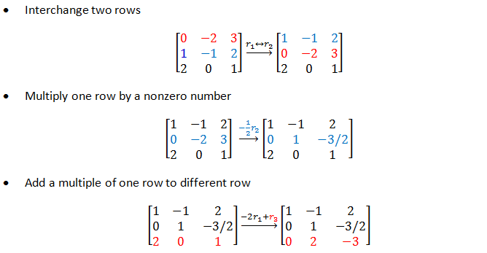
Elementary row operations

Slide 19
Gaussian Algorithm
Theorem. Every matrix can be brought to (reduced) row-echelon form by a series of elementary row operations
Step 1. If all row are zeros, stop
Step 2. Otherwise, find the first column from the left containing a nonzero entry (call it a) and move the row containing a to the top position
Step 3. Multiply that row by 1/a to creat the leading 1
Step 4. By subtracting multiples of that row from the rows below it, make each entry below the leading 1 zero
Step 5. Repeat step 1-4 on the matrix consisting of the remaining rows

Slide 20
Gaussian Algorithm
leading one
step 2
step 3
step 4
step 5

Slide 21
Example
Carry the matrix
to row-echelon matrix
to reduced row-echelon matrix

Slide 22
row-echelon matrix

Slide 23
reduced row-echelon matrix

Slide 24
The rank of a matrix
The rank of the matrix A, rankA = the number of leading ones in the reduced row-echelon form of A.
Rank 3

Slide 25
Gauss-Jordan Elimination (for solving a system of linear equations)
Step 1.Using elementary row operations, augmented matrix → reduced row-echelon matrix
Step 2. If a row [0 0 0…0 1] occurs, the system is inconsistent
Step 3. Otherwise, assign the nonleading variables as parameters, solve for the leading variables in terms of parameters
reduced row echelon matrix
z=t (parameter)
z is nonleading variable

Slide 26
inconsistent

Slide 27
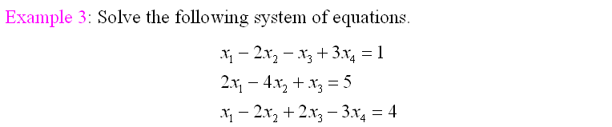
leading one
reduced row echelon matrix
x₂,x₄ are nonleading variables, so we set
x₂=t and x₄=s (parameters) and then compute x₁, x₃
x₁ = 2 + 2t - s
x₂ = t
x₃ = 1 + 2s
x₄ = s

Slide 28
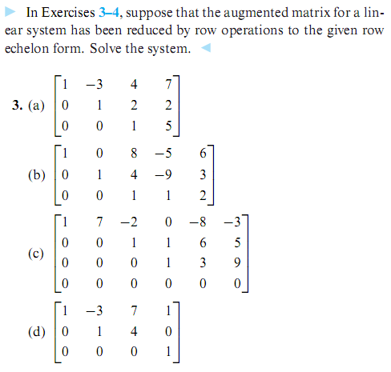

Slide 29
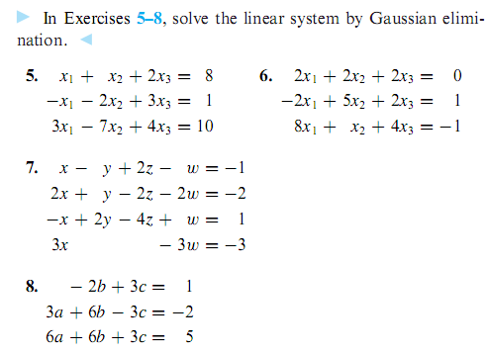

Slide 30
Theorem 2
Suppose a system of m equations in n variables has a solution. If the rank of the augment matrix is r then the set of solutions involves exactly n-r parameters
leading one
rankA=2
4(number of variables)- 2(rankA) =2 (two parameters : x₂=t, x₄=s)

Slide 31
1.3.Homogeneous Equations (phương trình thuần nhất)
The system is called homogeneous (thuần nhất) if the constant matrix has all the entry are zeros
Note that every homogeneous system has at least one solution (0,0,…,0), called trivial solution (nghiệm tầm thường)
If a homogeneous system of linear equations has nontrivial solution (nghiệm không tầm thường) then it has infinite family of solutions (vô số nghiệm)

Slide 32
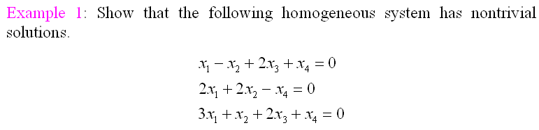

Slide 33
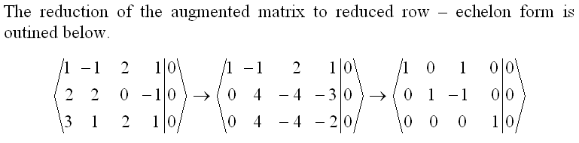
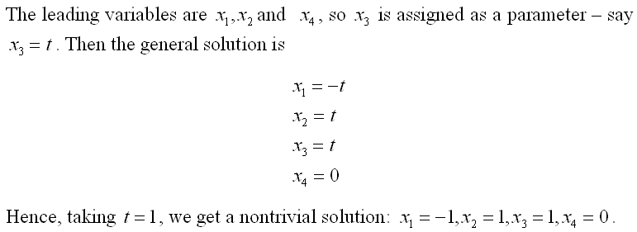
Hệ thuần nhất mà số ẩn
nhiều hơn số pt
Chắc chắn vô số nghiệm

Slide 34
Theorem 1
If a homogeneous system of linear equations has more variables than equations, then it has nontrivial solution (in fact, infinitely many)
Note that the converse of theorem 1 is not true

Slide 35
System of equations Summary
System of | Inconsistent ( no solutions) | Cosistent
 |  | Unique solution (exactly one solution) | Infinitely many solutions
linear equations | yes | yes | yes
linear equations that has more variables than equations | yes | no | yes
homogeneous linear equations | no | yes | yes
homogeneous linear equations that has more variables than equations | no | no | yes

Slide 36
Summary
Elementary Operations
Gaussian Elimination
Homogeneous Equations

Slide 37
Exercise 1.2.1 Which of the following matrices are in reduced row-echelon form? Which are in row-echelon form?

Slide 38
Exercise 1.2.2 Carry each of the following matrices to reduced row-echelon form.
Exercise 1.2.3 The augmented matrix of a system of linear equations has been carried to the following by row operations. In each case solve the system.

Slide 39
Exercise 1.2.4 Find all solutions (if any) to each of the
following systems of linear equations.

Slide 40
Exercise 1.2.5 Find all solutions (if any) to each of the following systems of linear equations.

Slide 41
Exercise 1.2.6 Express the last equation of each system as a sum of multiples of the first two equations. [Hint: Label the equations, use the gaussian algorithm.]
Exercise 1.2.7 Find all solutions to the following systems.

Slide 47
Exercise 1.3.1 Consider the following statements about a system of linear equations with augmented matrix A. In each case either prove the statement or give an example for which it is false.
a. If the system is homogeneous, every solution is
trivial.
b. If the system has a nontrivial solution, it cannot be
homogeneous.
c. If there exists a trivial solution, the system is homogeneous.
d. If the system is consistent, it must be homogeneous

Slide 48
Now assume that the system is homogeneous.
e. If there exists a nontrivial solution, there is no trivial solution.
f. If there exists a solution, there are infinitely many solutions.
g. If there exist nontrivial solutions, the row-echelon form of A has a row of zeros.
h. If the row-echelon form of A has a row of zeros, there exist nontrivial solutions.
i. If a row operation is applied to the system, the new system is also homogeneous.

Slide 49
Exercise 1.3.2 In each of the following, find all values of a for which the system has nontrivial solutions, and determine all solutions in each case.

Slide 50
Exercise 1.3.5 For each of the following homogeneous systems, find a set of basic solutions and express the general solution as a linear combination of these basic solutions.

Slide 51
Exercise 1.3.7 In each case determine how many solutions (and how many parameters) are possible for a homogeneous
system of four linear equations in six variables with augmented matrix A. Assume that A has nonzero entries. Give all possibilities.

Slide 52
THANKS

